Slide 1
Connectionist Computing
COMP 30230/41390
Gianluca Pollastri
office: CASL, ground floor Science East.
email: gianluca.pollastri@ucd.ie
Connectionist Computing COMP 30230

Slide 2



Credits
Geoffrey Hinton, University of Toronto.
  borrowed some of his slides for “Neural Networks” and “Computation in Neural Networks” courses.
Ronan Reilly, NUI Maynooth.
  slides from his CS4018.
Paolo Frasconi, University of Florence.
  slides from tutorial on Machine Learning for structured domains.
Connectionist Computing COMP 30230

Slide 3
Lecture notes on Moodle
https://csmoodle.ucd.ie/moodle/course/view.php?id=288
Strictly confidential...
Enrolment key: 30230cc
Connectionist Computing COMP 30230

Slide 4
Books
No book covers large fractions of this course.
Parts of chapters 4, 6, (7), 13 of Tom Mitchell’s “Machine Learning”
Parts of chapter V of Mackay’s “Information Theory, Inference, and Learning Algorithms”, available online at:
http://www.inference.phy.cam.ac.uk/mackay/itprnn/book.html
Chapter 20 of Russell and Norvig’s “Artificial Intelligence: A Modern Approach”, also available at:
http://aima.cs.berkeley.edu/newchap20.pdf
More materials later..
Connectionist Computing COMP 30230

Slide 5
Marking
3 landmark papers to read, and submit a 10-line summary on Moodle about: each worth 6.67%
a small connectionist tool to build and play with: 30%
Final exam: 50%
Connectionist Computing COMP 30230

Slide 6
Assignment 1
Read the first section of the following article by Marvin Minsky:
http://web.media.mit.edu/~minsky/papers/SymbolicVs.Connectionist.html
down to “.. we need more research on how to combine both types of ideas.”
Submit through Moodle a 250 word MAX summary by February 14th at 23:59, any time zone of your choice (Baker Island?).
One third of a grade down every day late, that is: if you deserve an A and you’re 1 day late you get an A-, 2 days late a B+, etc.
Make sure it's gone through!
Connectionist Computing COMP 30230

Slide 7
Hopfield vs. Boltzmann
Since in Boltzmann networks the unit update rule (or activation function) has a probabilistic component, if we allow the network to run it will settle into a given equilibrium state only with a certain probability.
Hopfield networks, on the other hand, are deterministic. Given an initial state their equilibrium state is determined.
Connectionist Computing COMP 30230

Slide 8
Stochastic units
Temperature makes it easier to cross energy barriers.
  Start at high temperature where its easy to cross energy barriers.
  Reduce slowly to low temperature where good states are much more probable than bad ones.
A B C
Connectionist Computing COMP 30230

Slide 9
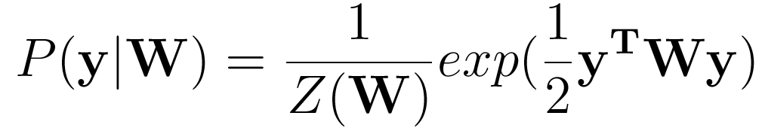
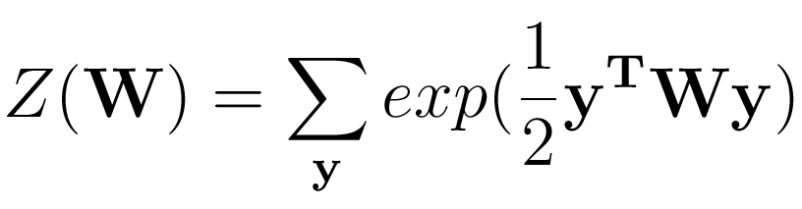
Implementing a probability distribution
It can be shown that the Boltzmann machine generates configurations according to the distribution:
Where:
Connectionist Computing COMP 30230

Slide 10
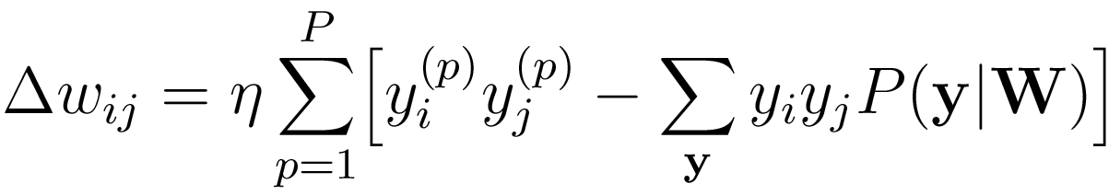
Learning in the Boltzmann machine
Working on the probability distribution it is possible to devise the following learning rule:
Connectionist Computing COMP 30230

Slide 11
Learning in the Boltzmann machine
The first term is readily evaluated from the examples.
The second term can be estimated by letting the model evolve until equilibrium, measuring the correlations, and repeating many times: can be computationally tough.
Monte Carlo.
Connectionist Computing COMP 30230

Slide 12
Hidden units for Hopfield nets/Boltzmann machines
Hidden units. Used to represent an interpretation of the inputs
Instead of using the net just to store memories, use it to construct interpretations of the input.
  The input is represented by the visible units.
  The interpretation is represented by the states of the hidden units.
Higher order correlations can be represented by hidden units.
More powerful model, but even harder to train.
Visible units. Used to represent the inputs
Connectionist Computing COMP 30230

Slide 13
Learning in the Boltzmann machine with hidden units
Even in this case we have two terms in Δwij.
The first term is the correlation between neurons i and j when the visible units are clamped to the examples.
The second is the correlation between neurons i and j when the system is let evolve freely.
Connectionist Computing COMP 30230

Slide 14
Learning in the Boltzmann machine with hidden units
In this case both terms must be estimated by letting the network evolve many times until equilibrium, in one case with the visible units clamped, in the other freely.
Not only: the missing units need to be estimated separately for each example.
Can be computationally very expensive
Connectionist Computing COMP 30230

Slide 15
Restricted Boltzmann Machines (RBM)
We restrict the connectivity to make inference and learning easier.
  Only one layer of hidden units.
  No connections between hidden units.
It only takes one step to reach equilibrium when the visible units are clamped..
j
hidden
visible
i
Connectionist Computing COMP 30230

Slide 16
Example 1: no hidden units
Only two examples:
(-1, -1, -1, -1, -1, -1)
(1, 1, 1, 1, 1, 1)
Train a Boltzmann machine without hidden units on them.
Connectionist Computing COMP 30230

Slide 17
Example 1: BM learning
Iterate:
First step: increase (i,j) connection strength by an amount proportional to the correlation between bits i and j of the examples:
Second step: let the BM machine run many times until equilibrium, measure the correlation between bits i and j of the final BM states and decrease (i,j) connection strength by an amount proportional to it.
Connectionist Computing COMP 30230

Slide 18
Example 1
Correlations in:
(-1,-1,-1,-1,-1,-1) and (1,1,1,1,1,1)
All the wij are 2η
NOTE: We can compute these at the beginning: they don’t change.
Connectionist Computing COMP 30230

Slide 19
Example 1
Learning parameters:
Learning rate η=0.1
Temperature T=1
“let the BM machine run many times until equilibrium”:
many times = 1000
until equilibrium = 600 neuron flips
Connectionist Computing COMP 30230

Slide 20
Example 1
Summary
Iterate:
  1) change all weights by +2η
  2) let the BM run from random starts 1000 times until it settles into y, decrease all weights by η times the correlations between the bits of y.
until no change
Connectionist Computing COMP 30230

Slide 21


Step 0
Reality
Dream
Connectionist Computing COMP 30230

Slide 22

Step 1
Reality
Dream
Connectionist Computing COMP 30230

Slide 23

Step 2
Reality
Dream
Connectionist Computing COMP 30230

Slide 24

Step 3
Reality
Dream
Connectionist Computing COMP 30230

Slide 25

Step 4
Reality
Dream
Connectionist Computing COMP 30230

Slide 26

Step 5
Reality
Dream
Connectionist Computing COMP 30230

Slide 27

Step 10
Reality
Dream
Connectionist Computing COMP 30230

Slide 28

Step 20
Reality
Dream
Connectionist Computing COMP 30230

Slide 29
Example 1
What happens if we let the trained BM evolve from random starts now?
-1 -1 -1 -1 -1 -1
-1 1 1 1 1 1
1 1 1 1 1 1
1 1 1 1 1 1
1 1 1 1 1 1
1 1 -1 1 1 1
-1 -1 -1 -1 -1 -1
1 1 1 1 1 1
1 1 1 1 1 1
1 1 1 1 1 1
-1 -1 -1 -1 -1 -1
1 1 1 1 1 1
-1 1 -1 -1 -1 -1
1 1 1 1 1 1
-1 -1 -1 -1 -1 -1
-1 -1 -1 -1 -1 -1
-1 -1 -1 -1 -1 -1
1 1 1 1 1 1
1 1 1 1 1 1
-1 -1 -1 -1 -1 -1
Connectionist Computing COMP 30230
A few rebels

Slide 30
Example 2: still no HU
Three examples now:
(1 -1 -1 1 1 1)
(-1 1 -1 1 1 1)
(-1 -1 1 1 1 1)
Train a BM on them
Connectionist Computing COMP 30230

Slide 31
Example 2
Correlations in the examples:
(1 -1 -1 1 1 1)
(-1 1 -1 1 1 1)
(-1 -1 1 1 1 1)
This is what we get:
0.3 -0.1 -0.1 -0.1 -0.1 -0.1
-0.1 0.3 -0.1 -0.1 -0.1 -0.1
-0.1 -0.1 0.3 -0.1 -0.1 -0.1
-0.1 -0.1 -0.1 0.3 0.3 0.3
-0.1 -0.1 -0.1 0.3 0.3 0.3
-0.1 -0.1 -0.1 0.3 0.3 0.3
x η
Connectionist Computing COMP 30230

Slide 32
Example 2
Learning parameters, same as in example 1:
Learning rate η=0.1
Temperature T=1
“let the BM machine run many times until equilibrium”:
many times = 1000
until equilibrium = 600 neuron flips
Connectionist Computing COMP 30230

Slide 33


Step 0
Reality
Dream
Connectionist Computing COMP 30230

Slide 34

Step 1
Reality
Dream
Connectionist Computing COMP 30230

Slide 35

Step 2
Reality
Dream
Connectionist Computing COMP 30230

Slide 36

Step 3
Reality
Dream
Connectionist Computing COMP 30230

Slide 37

Step 4
Reality
Dream
Connectionist Computing COMP 30230

Slide 38

Step 5
Reality
Dream
Connectionist Computing COMP 30230

Slide 39

Step 6
Reality
Dream
Connectionist Computing COMP 30230

Slide 40

Step 10
Reality
Dream
Connectionist Computing COMP 30230

Slide 41

Step 20
Reality
Dream
Connectionist Computing COMP 30230

Slide 42

Step 50
Reality
Dream
Connectionist Computing COMP 30230

Slide 43
Example 2
Original patterns:
(1 -1 -1 1 1 1)
(-1 1 -1 1 1 1)
(-1 -1 1 1 1 1)
We now let the BM converge from random points:
-1 1 1 -1 -1 -1
-1 1 -1 1 1 1
-1 1 1 -1 -1 -1
1 -1 1 -1 -1 -1
-1 1 -1 1 1 1
1 -1 1 -1 -1 -1
-1 -1 1 1 1 1
-1 -1 1 1 1 1
-1 -1 1 -1 -1 -1
-1 1 1 -1 -1 -1
1 1 -1 -1 -1 -1
1 -1 1 -1 -1 -1
1 1 -1 -1 -1 -1
-1 1 1 -1 -1 -1
1 1 -1 1 1 1
1 -1 1 -1 -1 -1
-1 -1 1 1 1 1
1 -1 1 -1 -1 -1
-1 1 1 -1 -1 -1
1 1 -1 -1 -1 -1
Connectionist Computing COMP 30230

Slide 44
Example 2
Original patterns:
(1 -1 -1 1 1 1)
(-1 1 -1 1 1 1)
(-1 -1 1 1 1 1)
We now let the BM converge from random points:
-1 1 1 -1 -1 -1
-1 1 -1 1 1 1
-1 1 1 -1 -1 -1
1 -1 1 -1 -1 -1
-1 1 -1 1 1 1
1 -1 1 -1 -1 -1
-1 -1 1 1 1 1
-1 -1 1 1 1 1
-1 -1 1 -1 -1 -1
-1 1 1 -1 -1 -1
1 1 -1 -1 -1 -1
1 -1 1 -1 -1 -1
1 1 -1 -1 -1 -1
-1 1 1 -1 -1 -1
1 1 -1 1 1 1
1 -1 1 -1 -1 -1
-1 -1 1 1 1 1
1 -1 1 -1 -1 -1
-1 1 1 -1 -1 -1
1 1 -1 -1 -1 -1
Just a few right ones
Connectionist Computing COMP 30230

Slide 45
Example 2
Original patterns:
(1 -1 -1 1 1 1)
(-1 1 -1 1 1 1)
(-1 -1 1 1 1 1)
We now let the BM converge from random points:
-1 1 1 -1 -1 -1
-1 1 -1 1 1 1
-1 1 1 -1 -1 -1
1 -1 1 -1 -1 -1
-1 1 -1 1 1 1
1 -1 1 -1 -1 -1
-1 -1 1 1 1 1
-1 -1 1 1 1 1
-1 -1 1 -1 -1 -1
-1 1 1 -1 -1 -1
1 1 -1 -1 -1 -1
1 -1 1 -1 -1 -1
1 1 -1 -1 -1 -1
-1 1 1 -1 -1 -1
1 1 -1 1 1 1
1 -1 1 -1 -1 -1
-1 -1 1 1 1 1
1 -1 1 -1 -1 -1
-1 1 1 -1 -1 -1
1 1 -1 -1 -1 -1
A good few opposites
Connectionist Computing COMP 30230

Slide 46
Example 2
Original patterns:
(1 -1 -1 1 1 1)
(-1 1 -1 1 1 1)
(-1 -1 1 1 1 1)
We now let the BM converge from random points:
-1 1 1 -1 -1 -1
-1 1 -1 1 1 1
-1 1 1 -1 -1 -1
1 -1 1 -1 -1 -1
-1 1 -1 1 1 1
1 -1 1 -1 -1 -1
-1 -1 1 1 1 1
-1 -1 1 1 1 1
-1 -1 1 -1 -1 -1
-1 1 1 -1 -1 -1
1 1 -1 -1 -1 -1
1 -1 1 -1 -1 -1
1 1 -1 -1 -1 -1
-1 1 1 -1 -1 -1
1 1 -1 1 1 1
1 -1 1 -1 -1 -1
-1 -1 1 1 1 1
1 -1 1 -1 -1 -1
-1 1 1 -1 -1 -1
1 1 -1 -1 -1 -1
Rebels
Connectionist Computing COMP 30230

Slide 47
Example 2
Problem here: second order relations are just not enough to model even this simple problem.
Need hidden units?
Connectionist Computing COMP 30230

Slide 48
Hidden Units
Hidden Units take time to be trained, and it is problematic to run a machine with them in any realistic case using the standard algorithm on a CPU.
Later in the course I'll talk about ways to overcome the issue.
Connectionist Computing COMP 30230

